Slide 1
Credit Risk Analytics Case Interview
July 2024

Slide 2
Contents
Introduction
Data Description
Exploratory Data Analysis
Methodology
Pair Plots
Plots
Findings and Discussion – I
Statistical Technique
Data Cleaning
Data Preprocessing – I
Correlation Matrix
Findings and Discussion – II
Machine Learning Models
Data Preprocessing – II
Predictive Modelling
Performance of the Models
Findings and Discussion – III
Recommendations
Future Studies
High-level Roadmap
Conclusion

Slide 3
Introduction
Problem Statement:
Bank Cred-etsy lacks clear insights into the effectiveness of their current credit card portfolio. This lack of understanding might be leading to:
Missed opportunities
Poor product design and services
High customer attrition
Objective:
To leverage the provided customer data to extract actionable insights that can optimize Bank Cred-etsy's credit card portfolio, driving both customer retention and engagement.
Key Performance Indicators:
Attrition rate
Transactions frequency
Transactions amount
Number of active customers/cards
Card utilization ratio
Notes:
This lack of understanding might be leading to:
Missed opportunities: They might not be offering the right credit card products to attract new customers or cater to existing ones.
Poor product design and services: Existing credit card products might not be optimized for maximum customer engagement and profitability for the bank.
High customer churn: Customers might be closing their accounts due to features that don't meet their needs or finding better deals elsewhere.

Slide 4
Introduction: Customer attrition
Definition:
The loss of customers by a business
Also known as customer churn
Expressed as a rate - attrition rate or churn rate
Median attrition rate in financial services company: 20%
Reasons:
Poor customer service
Difficult online experience
High fees
Limited credit limit increases
Lack of value proposition
It takes only 1 negative experience to make 32% of customers stop doing business with a brand.
Importance:
An important indicator of business health and strategic decision-making
Sources: CustomerGauge, Optimove, pwc

Slide 5
Data Description
Categorical Features | Numerical Features
Attrition_Flag | CLIENTNUM
Gender | Customer_Age
Education_Level | Dependent_count
Marital_Status | Months_on_book
Income_Category | Total_Relationship_Count
Card_Category | Months_Inactive_12_mon
 | Contacts_Count_12_mon
 | Credit_Limit
 | Total_Revolving_Bal
 | Avg_Open_To_Buy
 | Total_Amt_Chng_Q4_Q1
 | Total_Trans_Amt
 | Total_Trans_Ct
 | Total_Ct_Chng_Q4_Q1
 | Avg_Utilization_Ratio
Data Characteristics:
10127 records
21 features

Slide 6
Exploratory Data Analysis
Demographic Features | Engagement and Activity Features | Financial Features
Customer_Age | Months_Inactive_12_mon | Card_Category
Gender | Contacts_Count_12_mon | Months_on_book
Dependent_count | Total_Amt_Chng_Q4_Q1 | Total_Relationship_Count
Education_Level | Total_Trans_Amt | Credit_Limit
Marital_Status | Total_Trans_Ct | Total_Revolving_Bal
Income_Category | Total_Ct_Chng_Q4_Q1 | Avg_Open_To_Buy
 | Avg_Utilization_Ratio

Slide 7
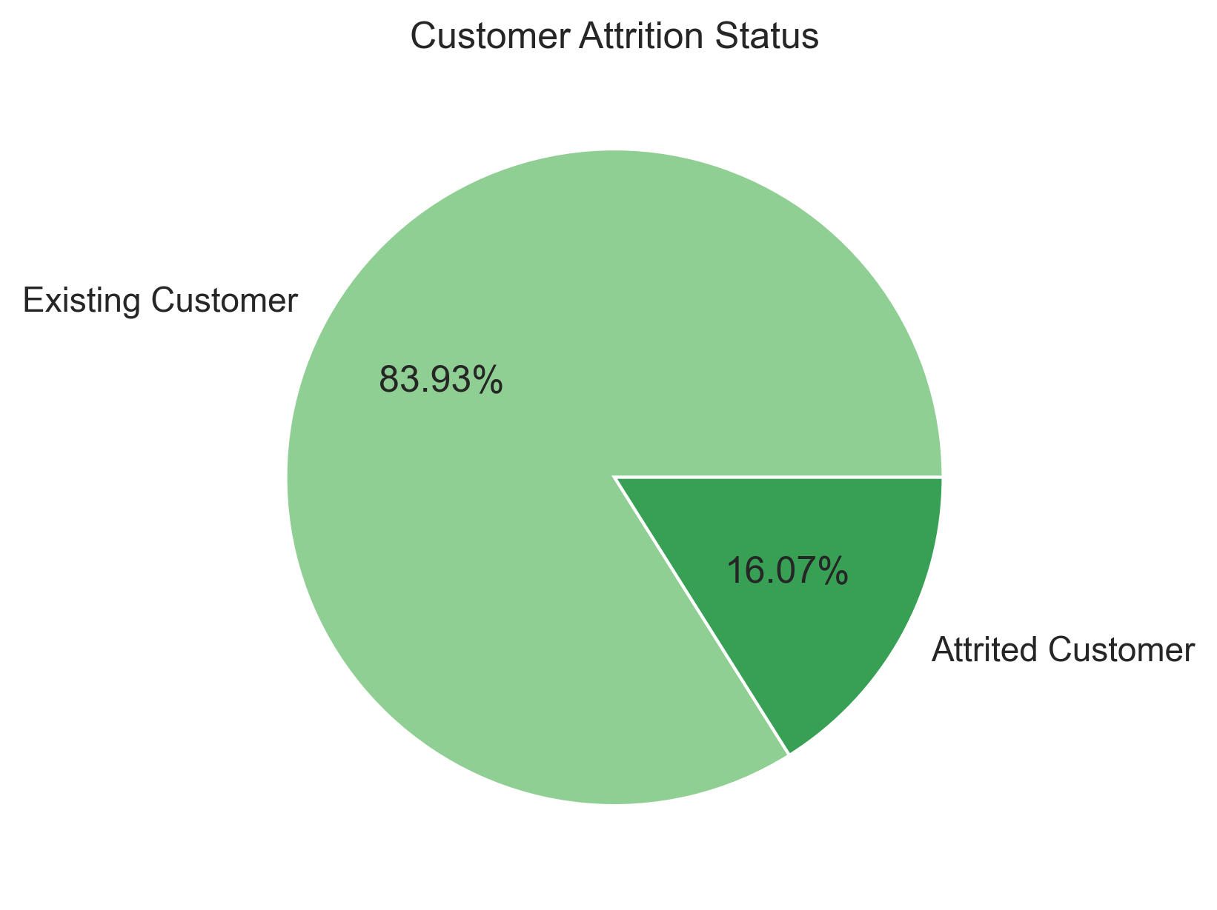
Exploratory Data Analysis: Attrition Rate
Notes:
In the first phase of our analysis, we'll conduct a deep dive into each feature individually. This will involve exploring the data in detail to understand its distribution and potential relationship to customer churn.

Slide 8
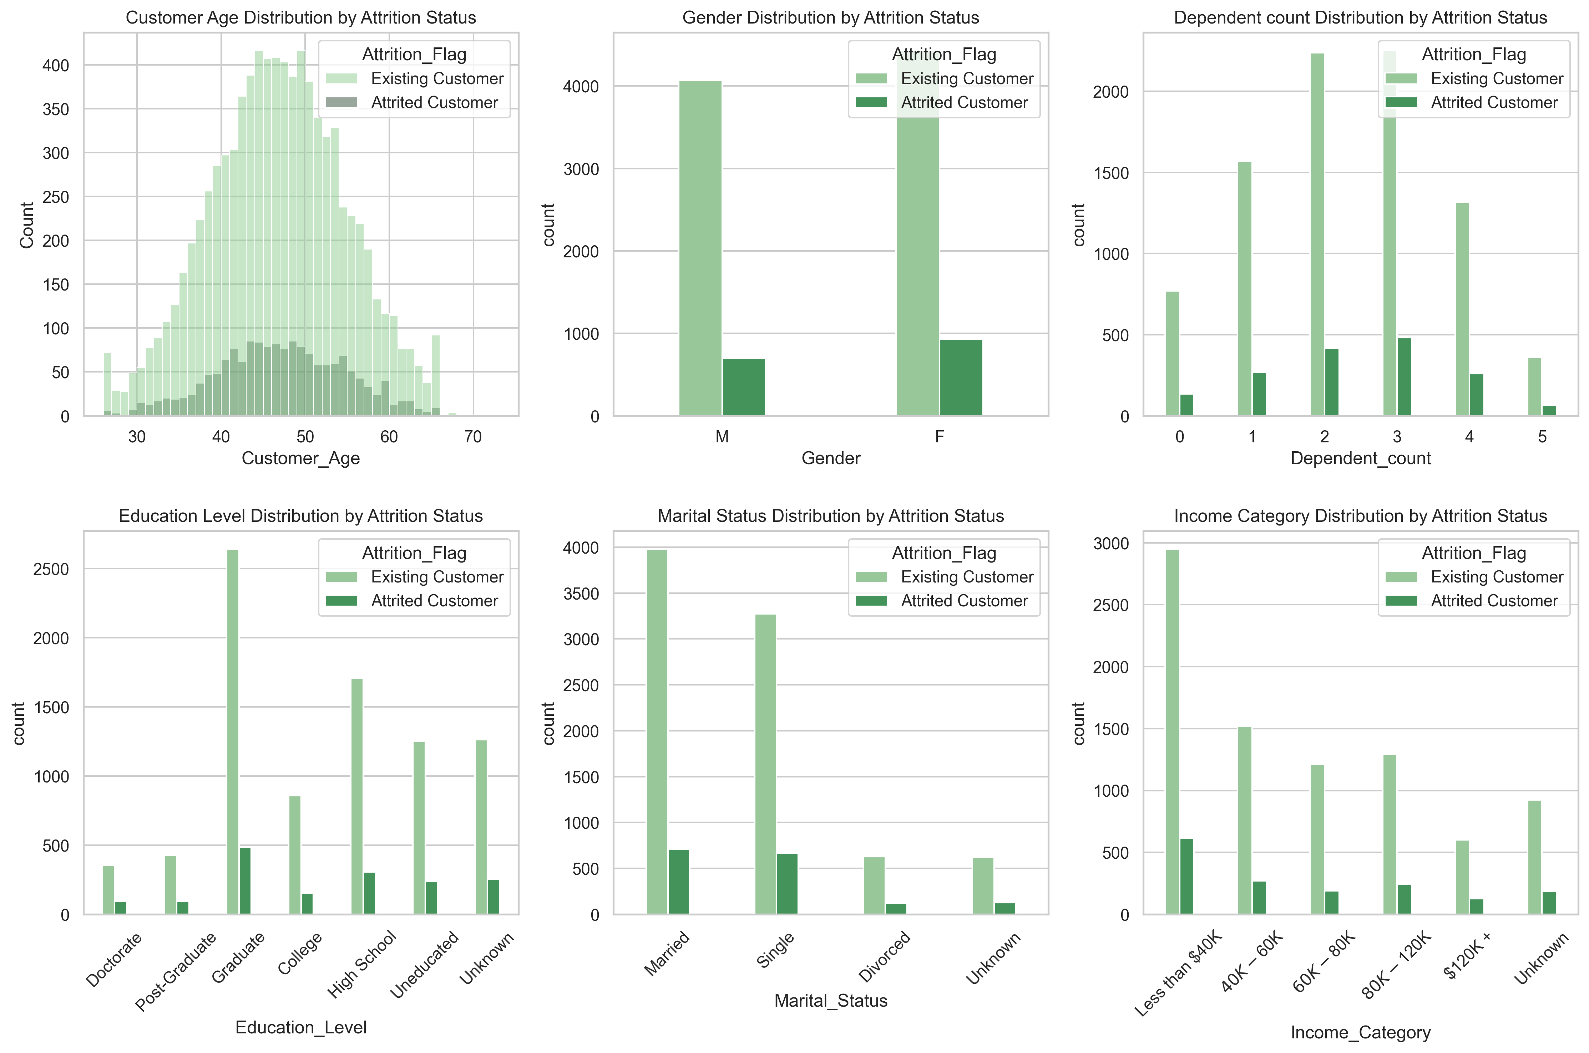
Exploratory Data Analysis: Demographic Features
Average age:46
77% being between 37 and 56
Around 52% of existing and
55% of attrited customers
have 2 or 3 dependents.
Around 66% of existing and
65% of attrited customers
have incomes below $80K.

Slide 9
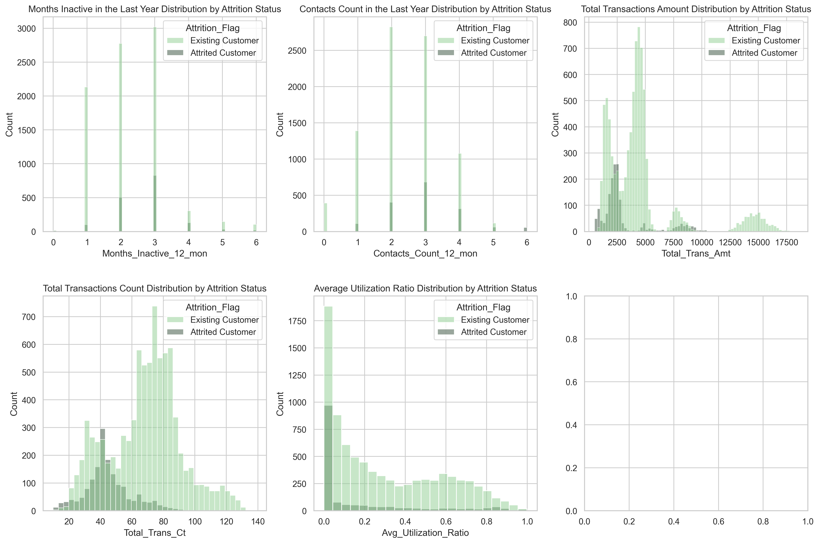
Exploratory Data Analysis: Engagement and Activity Features
The average credit utilization rate for existing customers is 0.29, compared to a lower rate of 0.16 for attrited customers.
Average total transaction amount for existing customers is $4,654, with 80% spending less than $5,000 annually.
For attrited customers, the average total transaction amount is lower at $3,095, and 80% of them spend less than $3,200 annually.
Existing customers make an average of 68 transactions, while attrited customers make an average of 44 transactions.
Average inactive months is between 2 and 3 months.

Slide 10
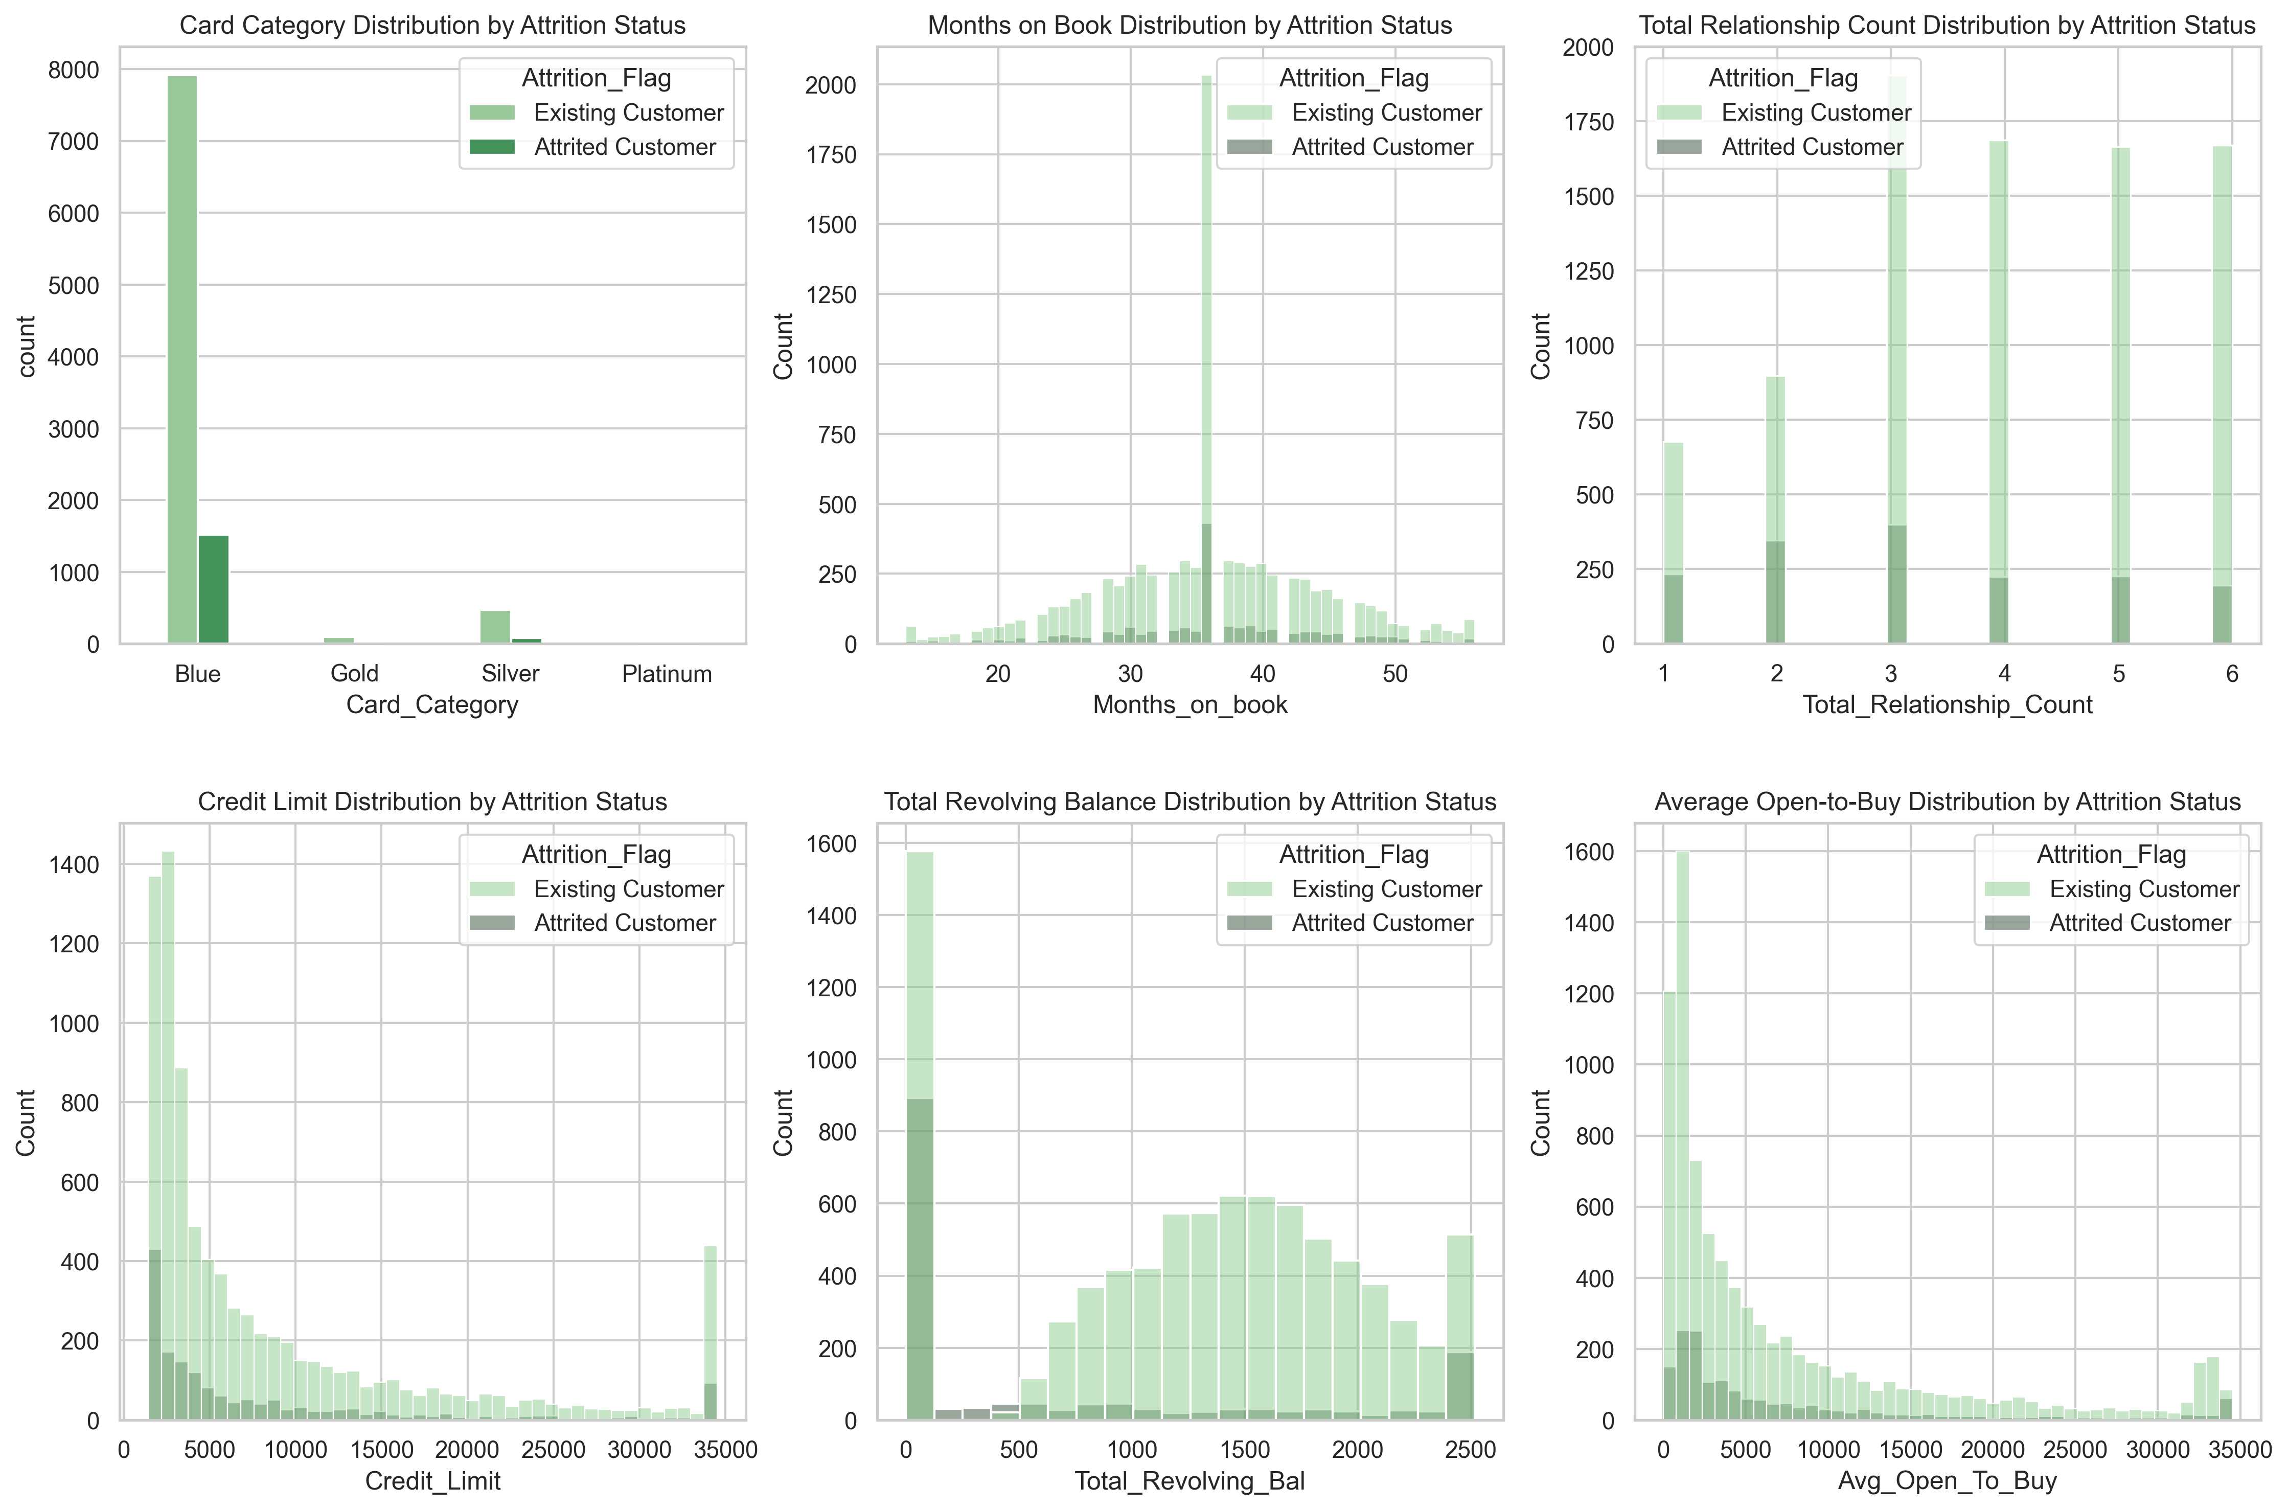
Exploratory Data Analysis: Financial Features
Among existing customers, 18% have a zero revolving balance. While 54% of attrited customers have a zero revolving balance.
The average credit limit for existing customers is $8,727, while for attrited customers it is slightly lower at $8,136.
More than 72% of existing customers and 75% of attrited customers have credit limits below $10,000.
Notes:
Our initial exploration focused on understanding the distribution of individual features for existing and attrited customers.
Now, we'll shift our focus to investigating the relationships between these features.
This means going beyond individual analysis and exploring how the features correlate with each other.

Slide 11
Questions: Is there a correlation between …
Transaction frequency and amount? (Do people who make more transactions, also tend to have higher transaction amounts?)
Credit limit and income? (Do people with lower credit limits also have lower income?)
Credit limit, balance, and amount owed? (Do people with lower credit limits tend to have less balance and owe less money?)
Utilization ratio and revolving balance? (Do people with a high utilization ratio have more revolving debt?)
Customer tenure and age? (Do customers who have been with the company longer tend to be older?)
Gender and open-to-buy/credit limit? (Do males generally have a higher open-to-buy amount and credit limit?)
Number of contacts and education level? (Is there a negative correlation between the number of contacts and education level?)
Inactive months and income? (Do customers who are inactive for longer periods tend to have lower income?)
Customer tenure and credit limit? (Do customers who have been with the company longer tend to have higher credit limits?)
Open-to-buy and revolving balance? (Is there an inverse relationship between open-to-buy amount and revolving balance?)
Open-to-buy and transaction frequency? (Do customers with a higher open-to-buy amount tend to make more transactions?)
Utilization ratio and income? (Is there a correlation between a high utilization ratio and lower income?)

Slide 12
Methodology
Pair plots
Statistical technique:
Correlation Matrix
Machine learning models:
Decision Tree
Logistic Regression
XGBoost

Slide 13
Pair Plots

Slide 14
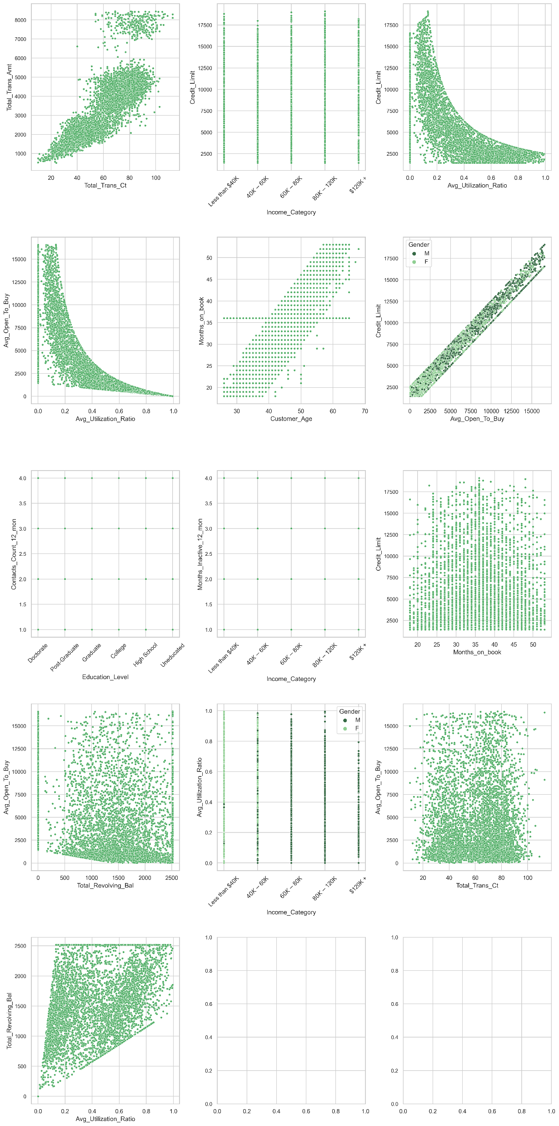

Slide 16
Findings and Discussion – I : Pair Plot
Customers who are more active (make more transactions) tend to spend more overall.
Each income category has a range of credit limits.
Customers with higher credit limits tend to use a smaller proportion of their available credit.
Customers with higher credit limits have more available credit (open-to-buy), regardless of gender.
Customers with higher open-to-buy amounts typically utilize a smaller portion of their credit.
The number of times a customer contacts the bank does not depend significantly on educational background.
Income does not have a strong influence on how often customers remain inactive.
Customers with higher open-to-buy amounts tend to have lower revolving balances.
Credit utilization behavior is varied across income levels.
How often customers transact does not directly relate to how much available credit they have.
Customers who use more of their credit limit tend to accumulate higher revolving balances.

Slide 17
Statistical Technique

Slide 18
Data Cleaning
Duplicate row?
No
Missing values?
No, but “Unknown” values in some columns
How to fix it?
Mode imputation
Outliers?
How to check it?
Statistical method called interquartile range (IQR = Q3-Q1)
Outliers?
Yes
How to fix it?
Remove the outliers (10127 records → 6463 records)
Notes:
Before proceeding to the next part, which is analyzing the correlation matrix. It's essential to address potential data quality issues. This is done through data cleaning process to ensure the accuracy and reliability of our findings.

Slide 19
Data Preprocessing - I
Data encoding: converting categorical data into numerical representation
Categorical Features
Attrition_Flag
Gender
Education_Level
Marital_Status
Income_Category
Card_Category
Binary Encoding
Label Encoding
One-Hot Encoding
Notes:
Once we've addressed data quality issues through cleaning, the next step involves encoding categorical data.
This process is crucial for performing correlation analysis, as correlation coefficients require numerical data.

Slide 20
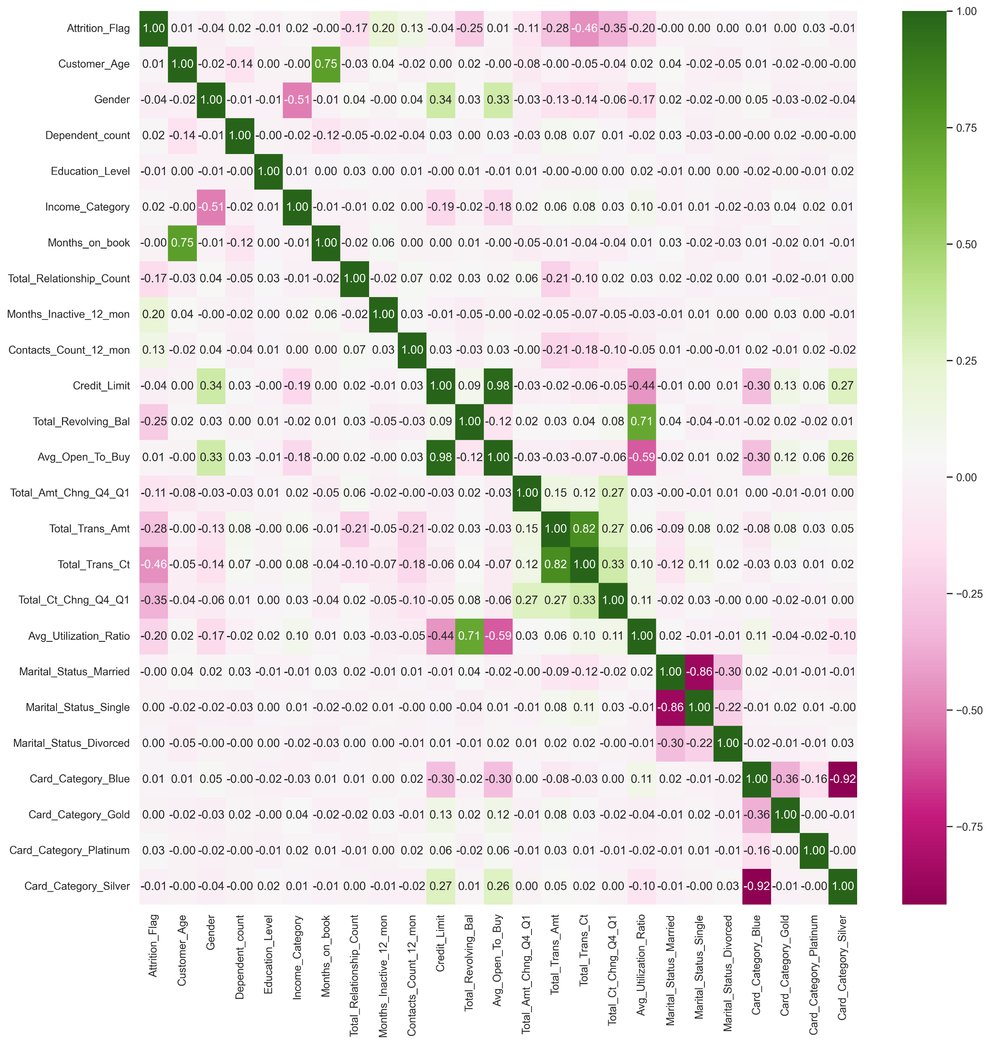




Correlation Matrix
The closer the number is to 1 (or -1), the stronger the correlation.
positive numbers → positive correlations
negative numbers →negative correlations

Slide 21
Findings and Discussion – II : Correlation
Customers with higher credit limits generally have lower utilization ratios.
There is a strong positive correlation between the average utilization ratio and the total revolving balance.
A higher utilization ratio is associated with a lower average open-to-buy.
Customers who make more transactions also tend to spend more overall.
There is a very strong positive correlation between average open-to-buy and credit limit.
Older customers tend to have been with the bank longer.
Customers who make more transactions are significantly less likely to churn.
Customers with higher total transaction amounts are less likely to churn.
Customers with greater changes in transaction count from Q1 to Q4 are less likely to churn.
Customers with more inactive months are slightly more likely to churn.
Customers with higher revolving balances are slightly less likely to churn.
Customers with higher utilization ratios are slightly less likely to churn.

Slide 22
Machine Learning Models

Slide 23
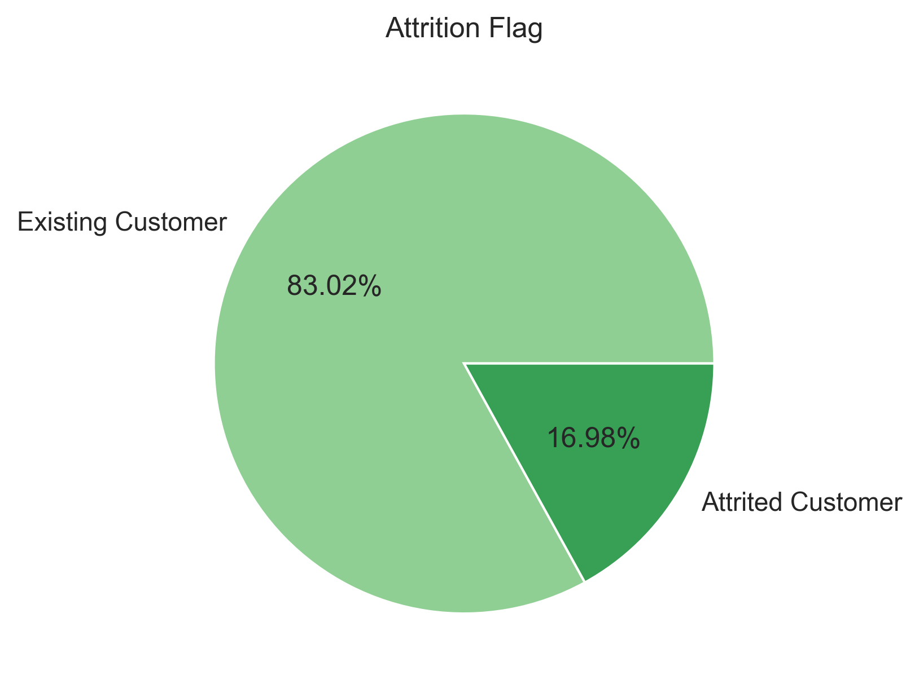
Data Preprocessing - II
Dataset is highly imbalanced.
Notes:
Before applying machine learning algorithms, we need to address an important preprocessing step related to class imbalance.
This significant difference indicates an imbalanced dataset, where the majority class (existing customers) far outnumbers the minority class (attrited customers).

Slide 24
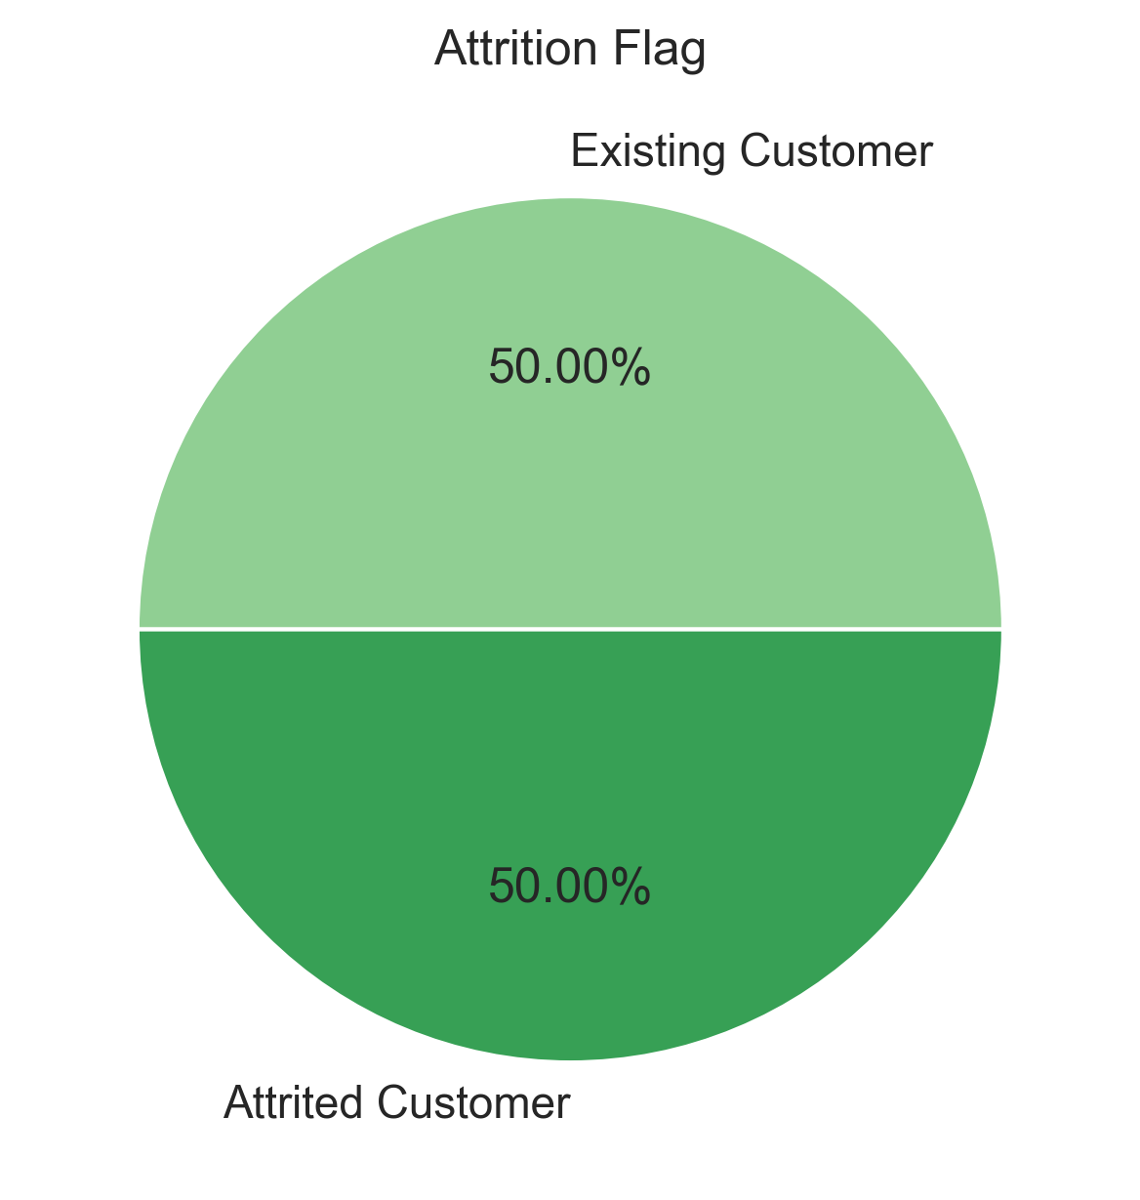
Data Preprocessing - II
Using the Synthetic Minority Oversampling Technique (SMOTE) to generate synthetic data points and augment the underrepresented minority class (attrited customers).

Slide 25
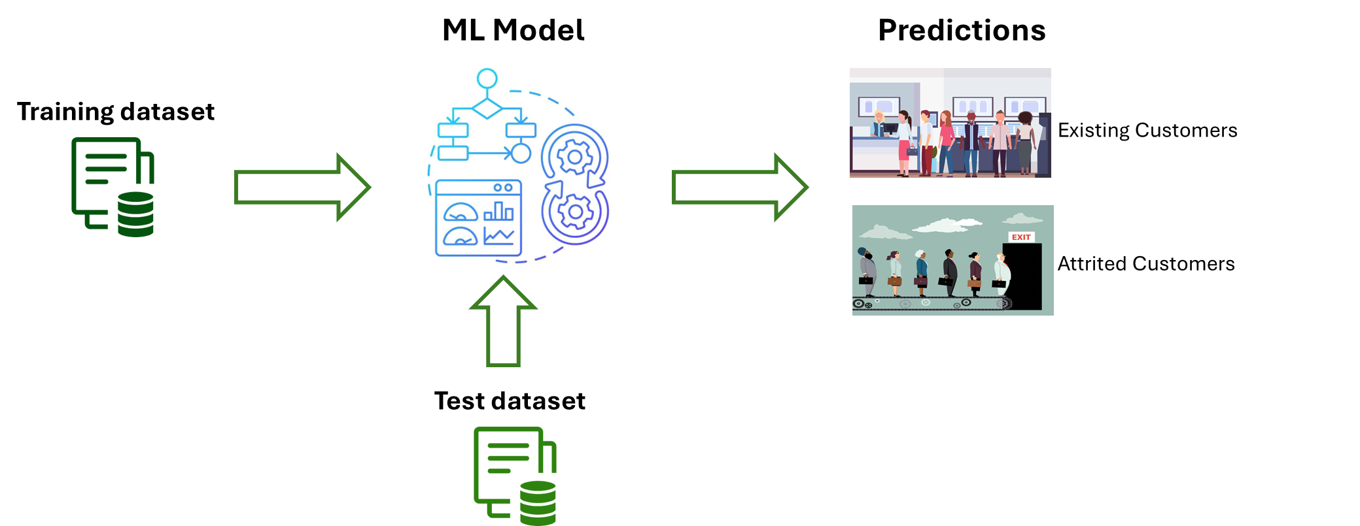
Predictive Modeling
Using the scikit-learn library in Python, models are trained on the training data. Then, their performance is evaluated on the test set.

Slide 26
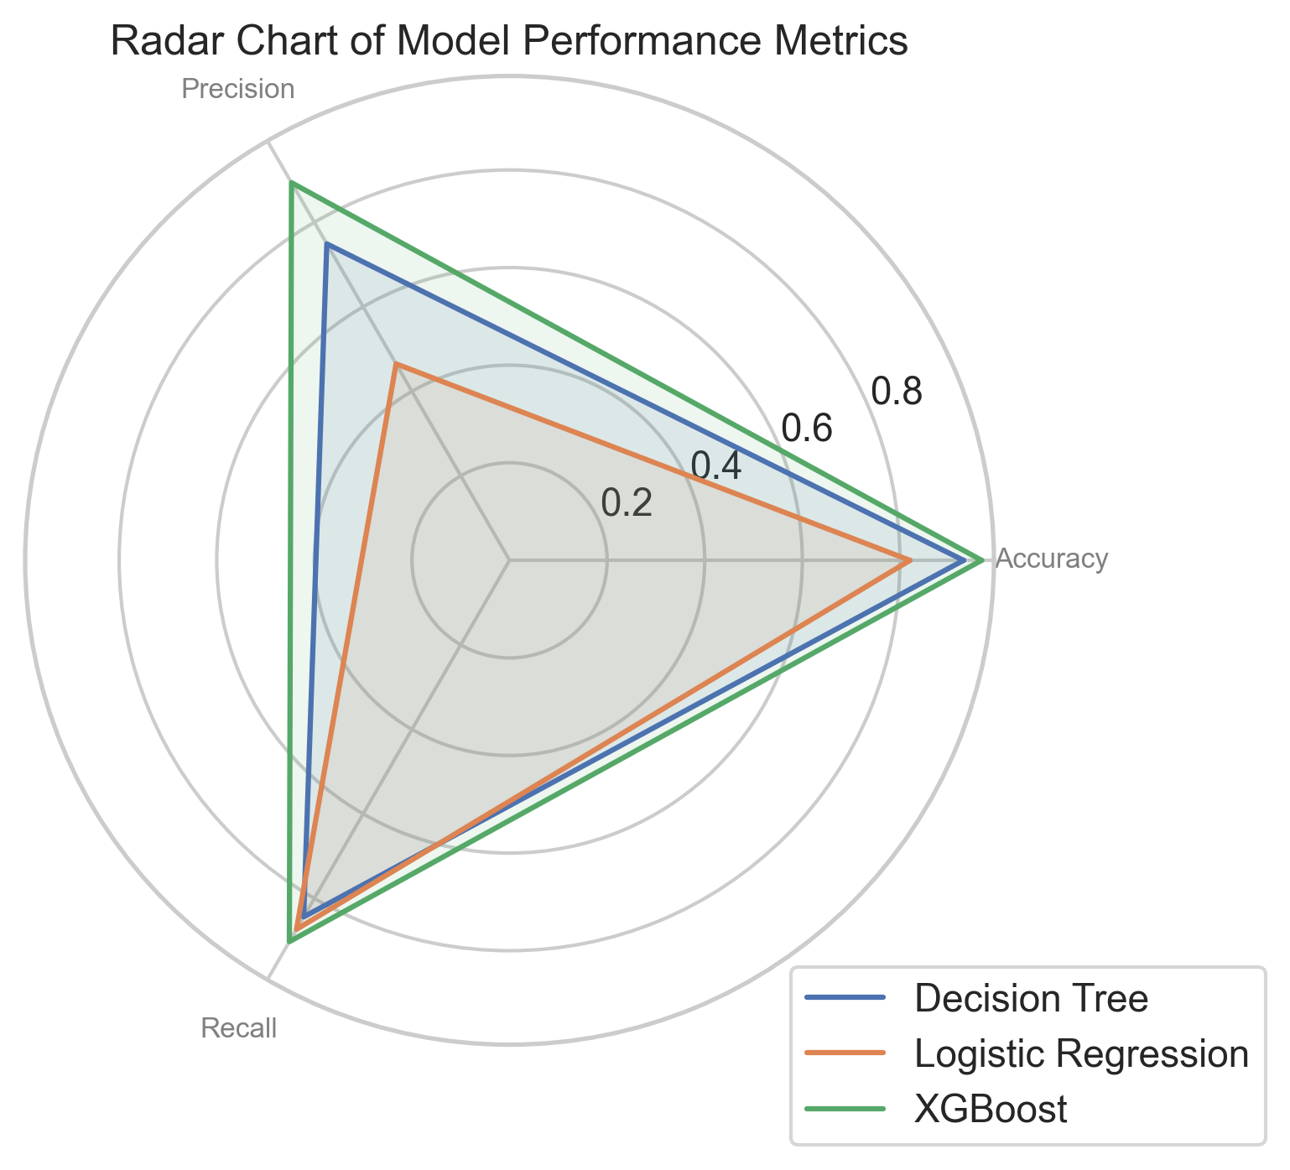
Performance of Models
The performance of the models using accuracy, precision, and recall metrics:
Accuracy: 96.7%
Precision: 89.4%
Recall: 90.2%
XGBoost
Notes:
We evaluate the performance of the algorithms with accuracy, precision, and recall metrics.
Each axis of the chart represents one of these metrics, with the center of the chart serving as the origin (zero point). The further out along each axis, the better the performance in that specific metric.

Slide 27
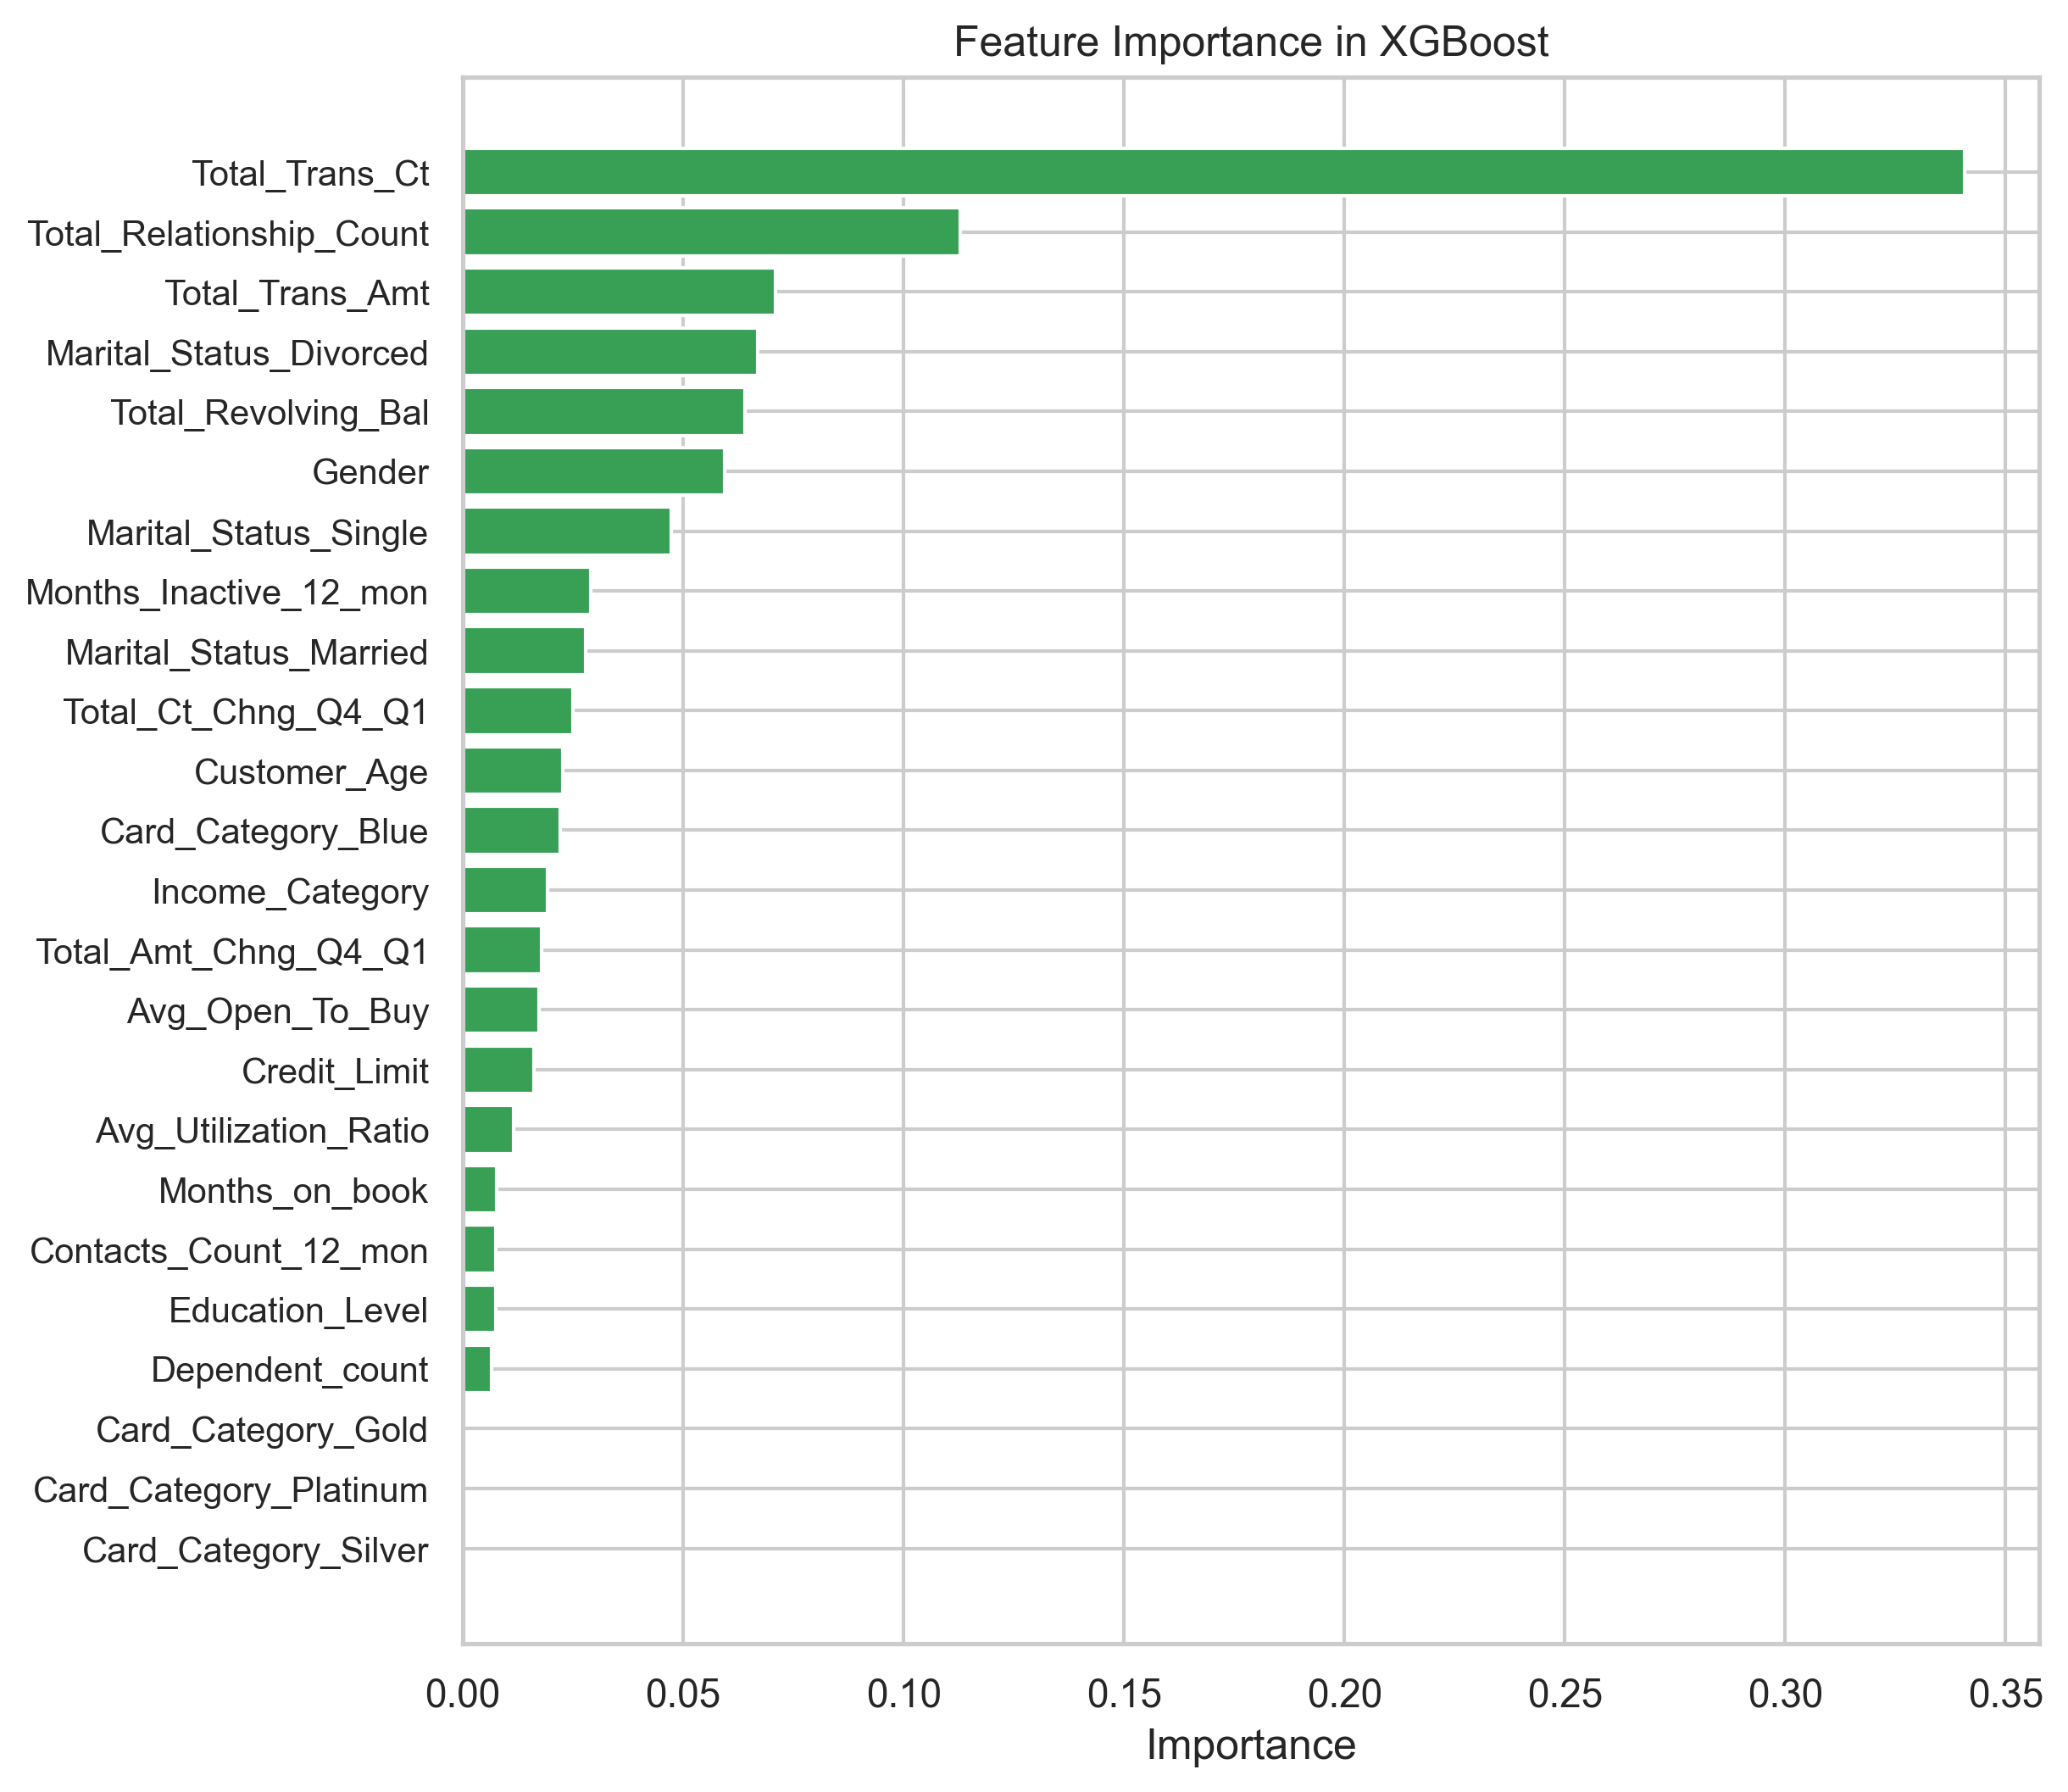
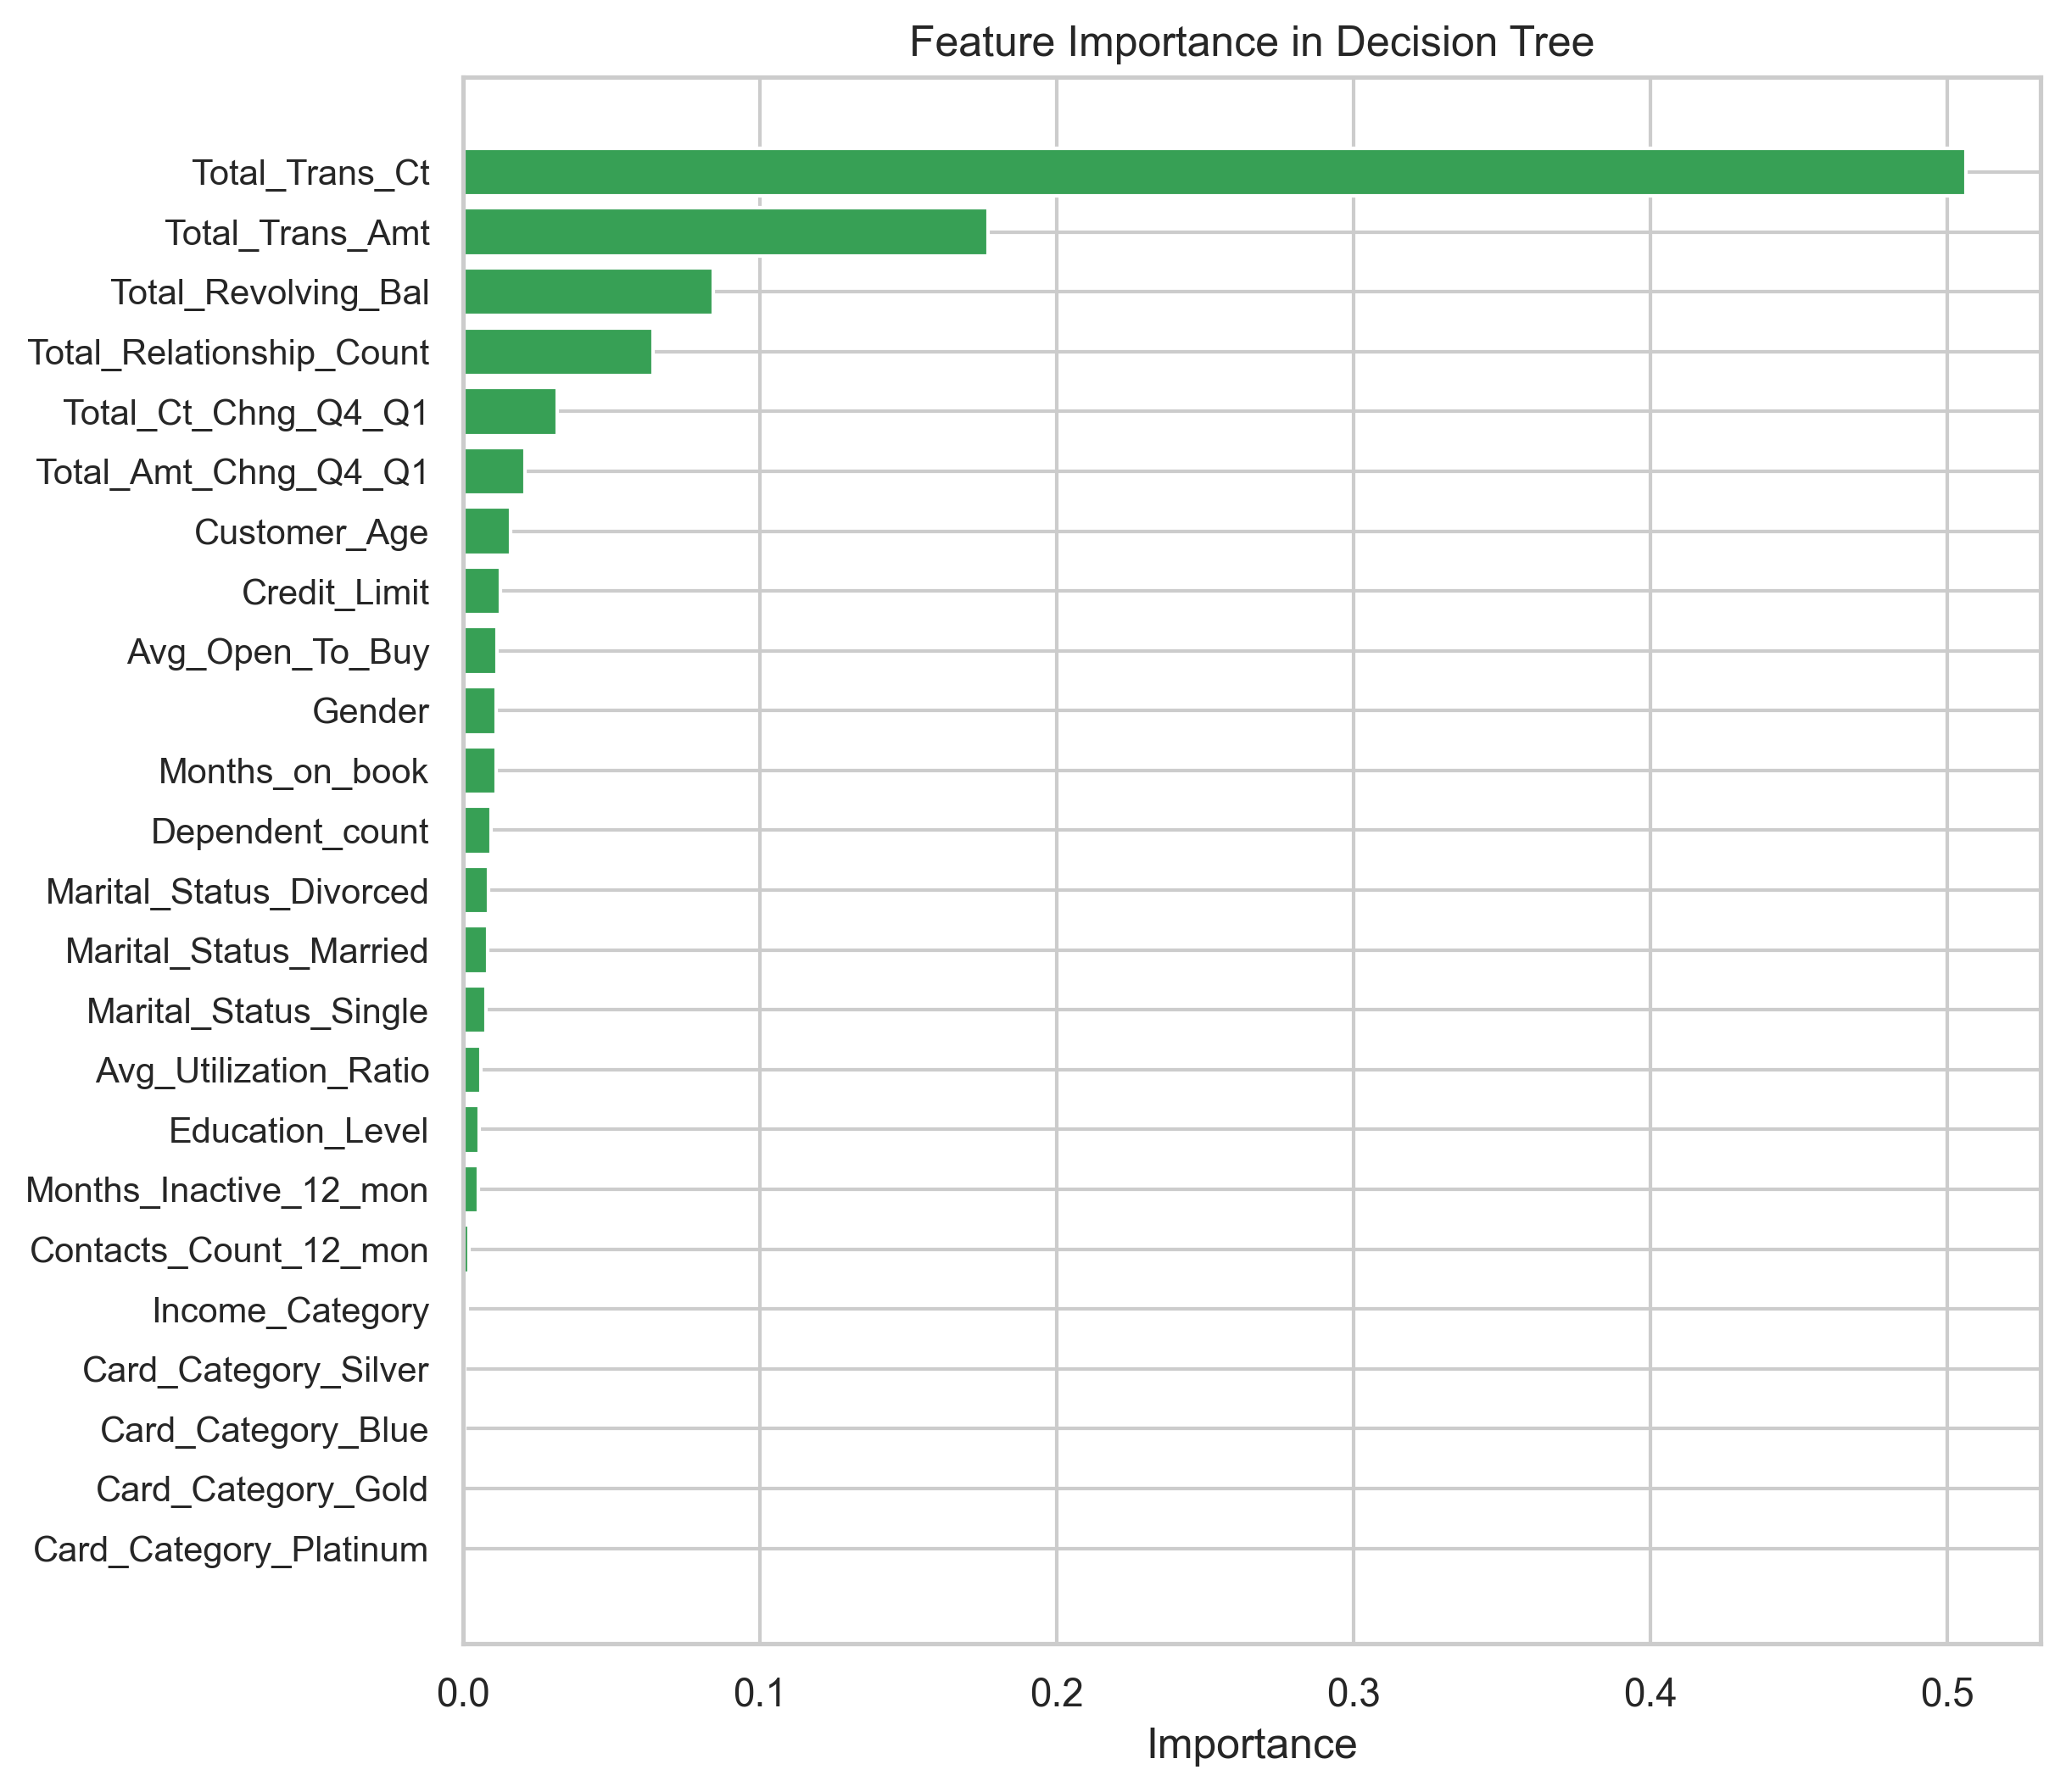
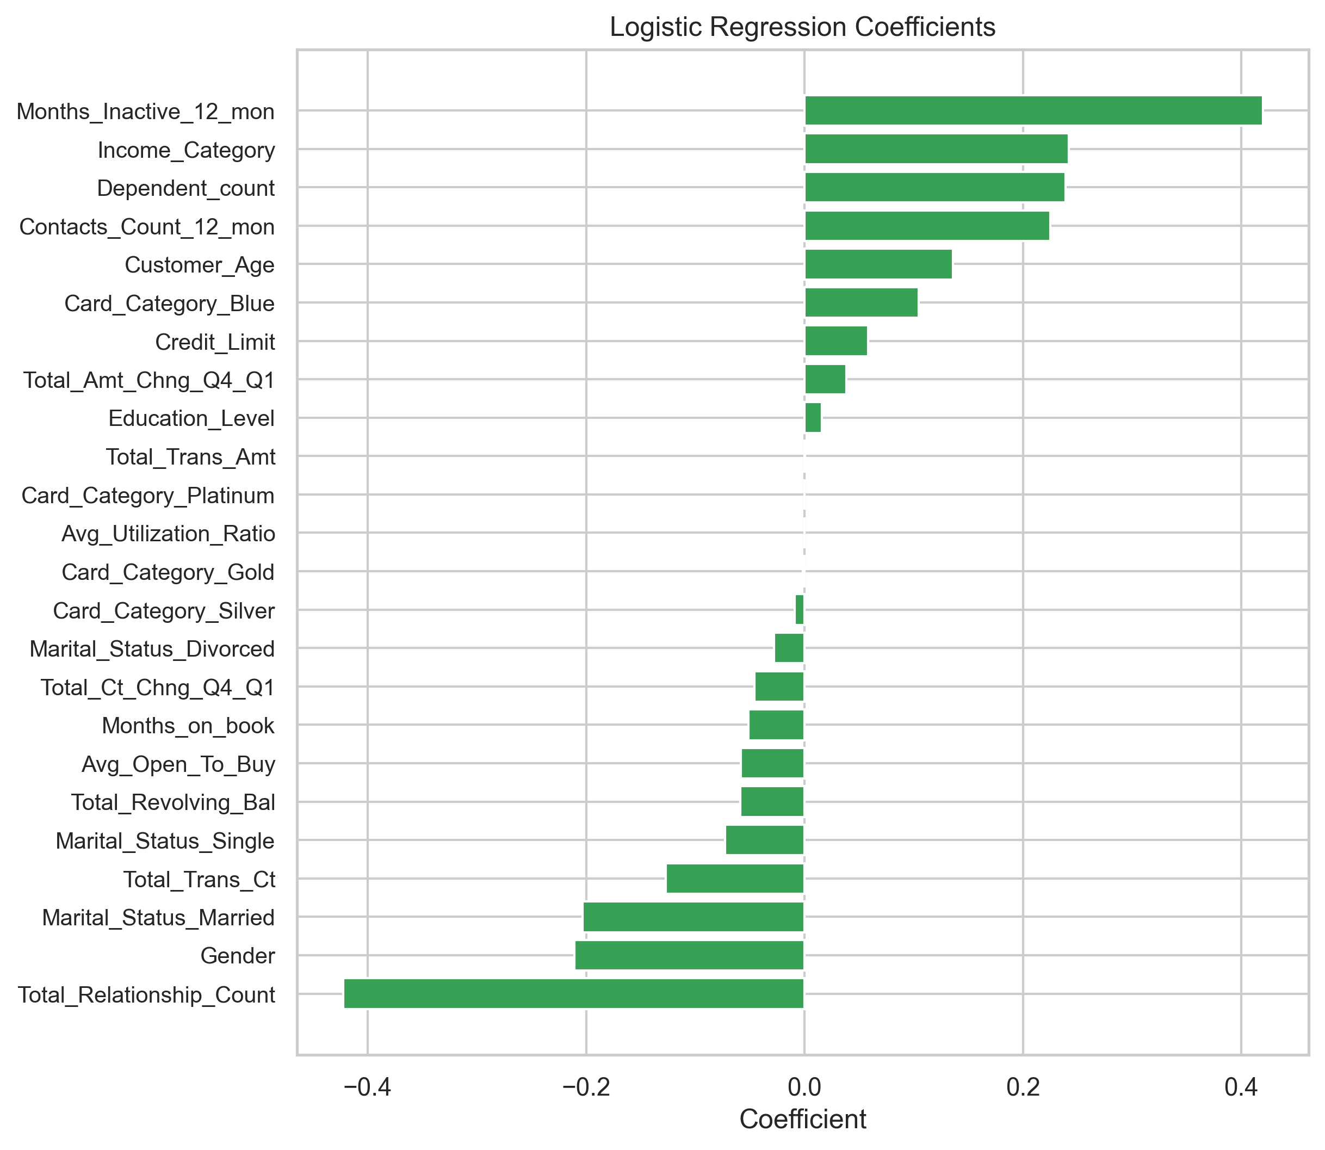
Findings and Discussion – III : ML
The importance of features on model prediction:

Slide 28
Recommendations
Engage Active Customers
Monitor Inactivity
Dynamic Transaction Analysis
Incentivize Frequent Transactions
Leverage Usage Patterns
Customer Segmentation
Notes:
Engage Active Customers: First and foremost, engaging active customers is crucial. Engaged customers feel valued and satisfied, reducing their likelihood of leaving the bank. Additionally, engaged customers are more likely to use a broader range of the bank's products and services. Satisfied customers tend to recommend the bank to friends and family, leading to positive word-of-mouth and potentially attracting new customers. To foster engagement, the bank could introduce personalized offers or rewards for continued loyalty.
Monitor Inactivity: It is essential to closely monitor customers with increasing inactivity. Implementing re-engagement strategies, such as targeted offers or reminders about benefits, can help reduce the likelihood of churn. Keeping customers active is key to maintaining their connection with the bank.
Dynamic Transaction Analysis: Regularly analyzing transaction patterns and identifying significant changes is important. Proactively reaching out to customers with declining transaction counts to understand their needs can prevent churn. Since more transactions typically indicate higher engagement, understanding and addressing the reasons for declining transactions is crucial.
Incentivize Frequent Transactions: The number of transactions significantly influences attrition, as revealed by our analysis. To encourage more frequent transactions, the bank could introduce incentives. For example, a rewards program where customers earn points for every set number of transactions. Once these points accumulate to a certain level, they could be redeemed for discounts or other benefits. Offering cashback on transactions could also be an effective strategy.
Manage Utilization Wisely: Utilization is a double-edged sword. Both high and low utilization can be unfavorable. Low utilization suggests underuse of the card, leading to less engagement and fewer transactions. High utilization can be risky if it is coupled with high revolving balances, as it may indicate potential repayment issues. I recommend identifying customers with high utilization ratios and high revolving balances, flagging these accounts for further review, and providing targeted financial advice to manage their credit better. Highlighting benefits or payment plans can keep them engaged and reduce their likelihood of default. (high ut and high rev also could mean more profit)
For customers who frequently use most of their available credit and maintain moderate revolving balances, the bank could consider offering higher credit limits. This approach aligns with the observed correlation between higher utilization and lower open-to-buy amounts, and between open-to-buy amounts and credit limits. Offering higher credit limits to these customers may increase their satisfaction and continued use of the card. (upselling opportunities)
Customer Segmentation: Lastly, I recommend implementing customer segmentation. Segmentation can be based on various attributes, such as transaction behavior, financial behavior (e.g., card utilization, revolving balance), or a combination of features. Effective customer segmentation helps the bank engage customers more effectively by targeting them with specific promotions and services. It also aids in identifying high-risk profiles for proactive default prevention measures.
Attract new customers and retain existing ones.
Increase customer engagement and credit card usage.
Maximize profitability of their credit card offerings.
Become more competitive in the credit card market.

Slide 29
Future Studies
Segmentation Analysis
Predictive Modeling Enhancements
Risk Management

Slide 30
High-level Roadmap
Strategic Planning | Data Integration | Analytics and Insights | Financial Guidance | Customer Connection | Improvement and Optimization
Develop a detailed project plan. | Integrate data from various sources. | Analyze data and develop models. | Provide financial management advices. | Identify customer's needs and develop offers. | Continuously refine strategies.
Project Manager Business Analysts Budget | Data Engineers Data Analysts Budget | Data Scientists | Financial Advisors BD Analyst | BD Analysts Customer Service Rep Budget | BI Analyst
Goal
Resources
Notes:
Strategic Planning: The first step is strategic planning. For example, to engage customers and increase their transactions, the bank might consider developing a reward plan or loyalty program. This phase involves creating a detailed execution plan. The necessary resources include a project manager, business analyst, and a budget assessment. It is crucial to determine the budget available for the project.
Data Collection and Integration: Next, we move to the data collection and integration phase. This step is essential as all analyses are data-driven. Integrating diverse data sources into a unified system is crucial to provide a comprehensive and accurate view of customer behavior. For this phase, we need data engineers and data analysts. Additionally, there might be a need for a budget to rent cloud data warehouses or acquire other data services.
Analytics: The subsequent step is analytics. For most of the recommendations, we need to analyze data and customer behavior to extract actionable insights. This phase includes tasks like segmenting customers for targeted offers to engage them and increase their utilization. Here, we require data scientists to perform the necessary analyses.
Financial Guidance: In the financial guidance phase, financial advisors are needed to provide personalized financial advice and support. Based on the usage patterns analyzed in the previous steps, we now need to offer tailored financial guidance to specific customers.
Customer Engagement and Implementation: This phase involves connecting with customers to understand their needs better and gather feedback. It also includes implementing the insights from the analytics phase. For this, we need business development and customer service teams. There may also be a need for a budget to support marketing campaigns.
Continuous Monitoring and Improvement: Establishing monitoring frameworks to track the effectiveness of engagement strategies and financial advice programs is vital. The bank should continuously refine its strategies based on customer feedback and emerging trends. This should be an ongoing task. Business intelligence analysts will be essential in this phase to ensure continuous improvement.

Slide 31
Conclusion
Customer Behavior Insights
Attrition Factors
Actionable Recommendations
High-Level Roadmap
Notes:
In conclusion, our data analysis study on Bank Cred-etsy has yielded significant insights into customer behavior. By leveraging data visualization techniques, we were able to gain a deeper understanding of customer trends and patterns. Additionally, we employed statistical techniques [or/and] machine learning models to identify key factors contributing to customer churn. Based on these findings, we have developed actionable recommendations to improve bank practices and address customer pain points. Finally, we have created a high-level roadmap to guide the implementation of these recommendations. By taking these steps, Bank Cred-etsy can work towards reducing customer churn and fostering stronger customer relationships.“

Slide 32
Thanks For Your Attention!

Slide 33




Predictive Modeling
80/20 random split
ML Model
Predictions
Training dataset
Existing Customers
Attrited Customers
Test dataset

Slide 34
Data cleaning and preprocessing workflow
Test set
Existing: 1088
Attrited: 205
Original Dataset
After removing outliers
Existing: 8500
Attrited: 1627
Existing: 5380
Attrited: 1083
Training set after balancing the data
Training set
Existing: 4292
Attrited: 878
Existing: 4292
Attrited: 4292

